Slide 1
Analysis of adverse reactions from COVID-19 vaccines and study of various factors contributing to the side effects.
Dallas Hutchinson, Apoorv Awasthi, Navya Shruthi Potana, Vijayani Bomma, Doddamreddy Sai Anmisha, Gayathri Gurram.

Slide 2

Introduction
With the emergence of Covid-19, everyone was pushed into a state of emergency.
Covid-19 vaccine was introduced to reduce the risk of infection. However, there have been reports of Covid-19-related side effects.
“The COVID-19 vaccines can cause mild adverse effects after the first or second doses” (Meo et. al, 2021).
As a result, it's critical to investigate the vaccine's side effects so that proper precautions can be taken.

Slide 3


Aim
Identify the relationships between COVID-19 vaccines and its side effects in order to provide safe vaccines to individuals

Slide 4
Research Questions
Is there a relationship between number of days to show symptoms and number of symptoms caused by the vaccines?
Can we predict the severity of adverse effects based on factors such as age, gender, vaccine manufacturer and medical history?
Is there a significant difference in age between patients who experienced no severe effects and patients who did?

Slide 5
Methodology
DATA COLLECTION: COVID-19 World Vaccine Adverse Reactions. https://www.kaggle.com/ayushggarg/covid19-vaccine-adverse-reactions?select=2021VAERSDATA.csv
DATA EXTRACTION, CLEANING: Identifying and removing null values/duplicate rows, remove unnecessary attributes, create dummy variables
EXPLORATORY DATA ANALYSIS: Summary statistics, Normality/Correlation tests, Visualize the data
DEVELOPING A MODEL
PERFORMANCE ANALYSIS OF THE MODEL
RESULTS

Slide 6
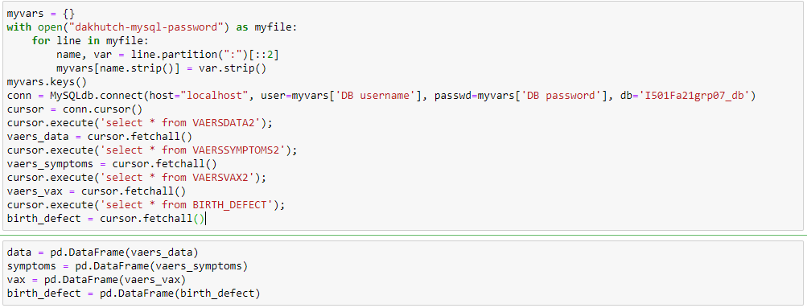
Importing the Dataset

Slide 7
Data cleaning
Renamed the columns
Converted columns like Died, hospitalization, life threatening, disable and birth defect to Boolean values (0 and 1)
Got the symptom count of all the patients based on the symptom count table
Merged all the 4 csv files
Dropped unnecessary columns
Replacing null values in the required columns by np.nan
Dropped rows with NA values in columns [age, sex, symptom_count, numdays]
Dropped rows where numdays > 45
Dropped rows where symptom count > 25

Slide 8
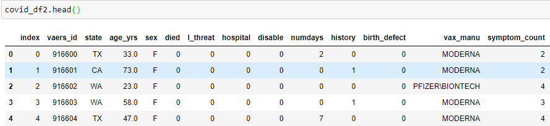
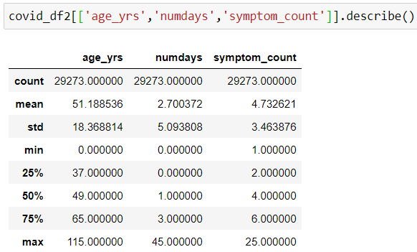
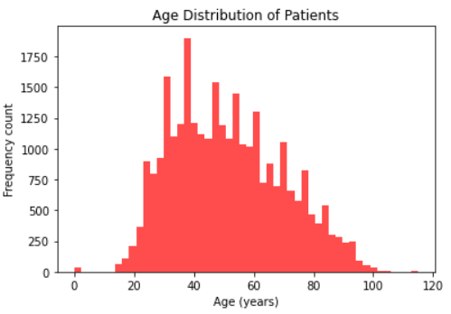
Descriptives + EDA

Slide 9
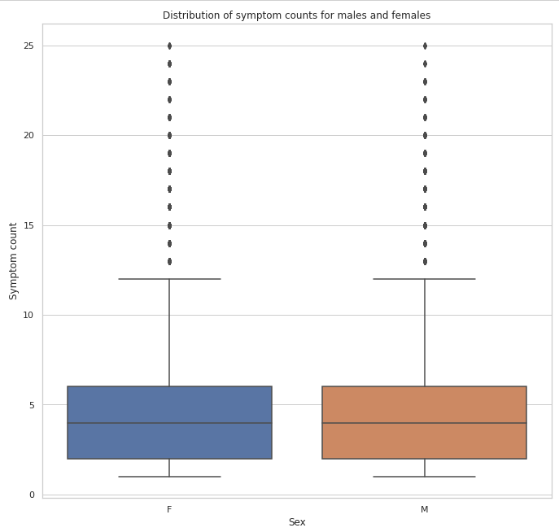
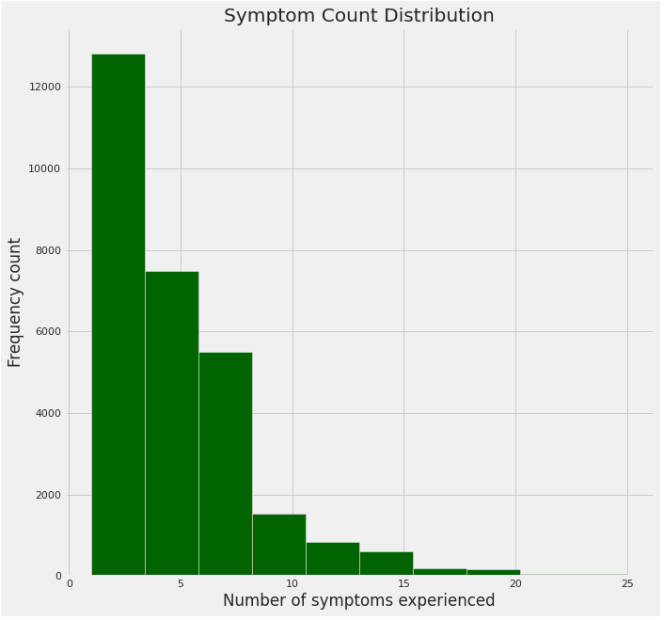
Visualizations

Slide 10
Research Question
Is there a relationship between number of days to show symptoms and number of symptoms caused by the vaccines?

Slide 11
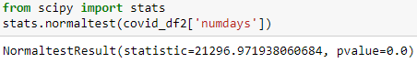
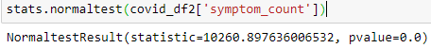
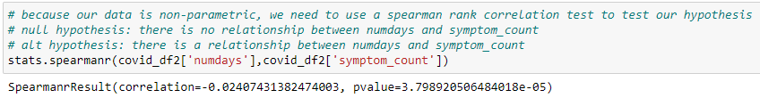
Is our data normally distributed?
Number of days to show symptoms:
Number of symptoms experienced:
Test the hypothesis using the Spearman rank and Kendall correlation test
Result: Evidence suggests to reject the null hypothesis. There is an inverse relationship between number of days to show symptoms and symptom count.
(Although the correlation coefficient tells us is extremely close to 0)

Slide 12
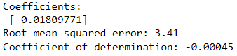
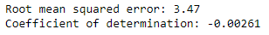
Linear and polynomial regression
Independent Variable: “numdays” (number of days to show symptoms)
Dependent Variable: “symptom_count” (number of symptoms experienced)
As “numdays” increases, does number of symptoms experienced increase/decrease/stay constant?
Linear regression results
Polynomial regression results (degree = 3)

Slide 13
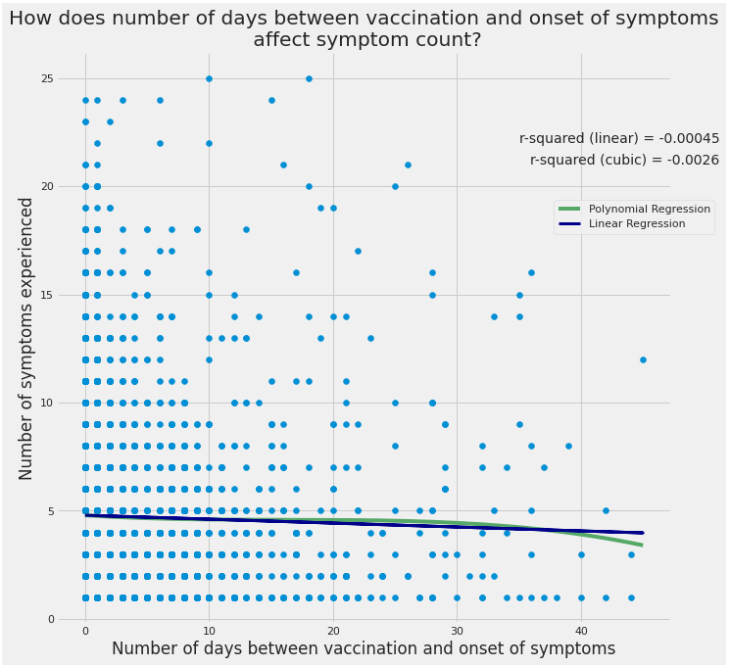

Slide 14
Research Question
Can we predict the severity of adverse effects based on factors such as age, gender, vaccine manufacturer and medical history?

Slide 15
Getting the Target variable
Using columns – l_threat, Died, hospital, disable, birth_defect
Summing the values of above column and creating classes based on the sum value
If sum = 0, Class – No Severity (0)
If sum = 1, Class decided based on which column contributes towards this sum. We get five classes from this: Class – Life threatening (1), Died(6), hospital(2), disable(3) and birth defect(4)
If sum >1, Class – Very Serious (5)
So we have Target variable which has 7 classes

Slide 16
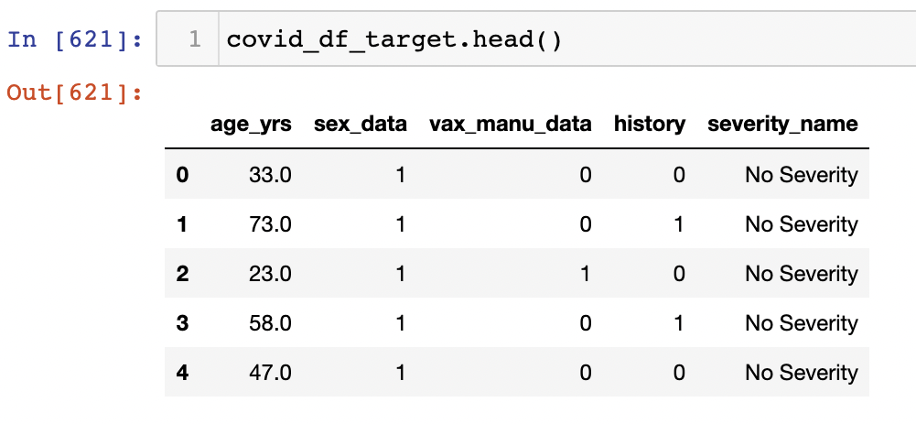
Input variables
Assigning sex column a number and creating the new list by sex_num - Male is assigned to 0, female assigned to 1
Assigning vax_manu a number and creating the new list by vaxmanu - Moderna assigned to 0, Pfizer assigned to 1, Janssen assigned to 2
Extracting the input attributes with the target in the new DataFrame for modelling.

Slide 17
Classification models used
Random forest model (acc = 0.794)
Gradient boosting classification (acc = 0.743)

Slide 18
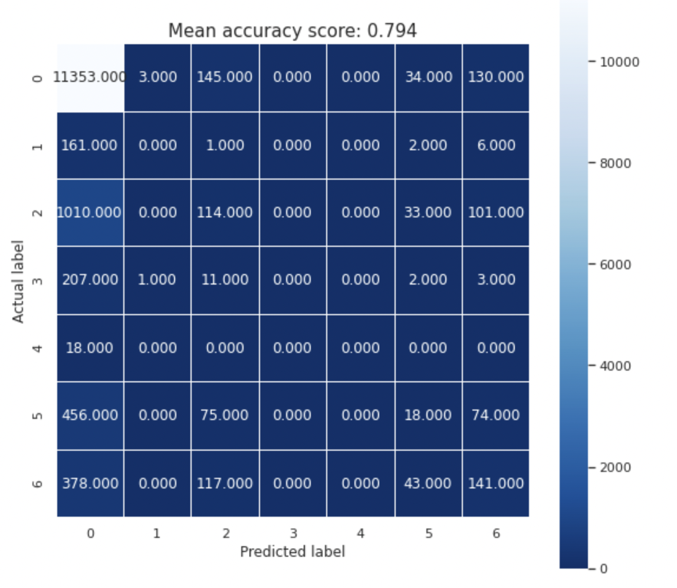
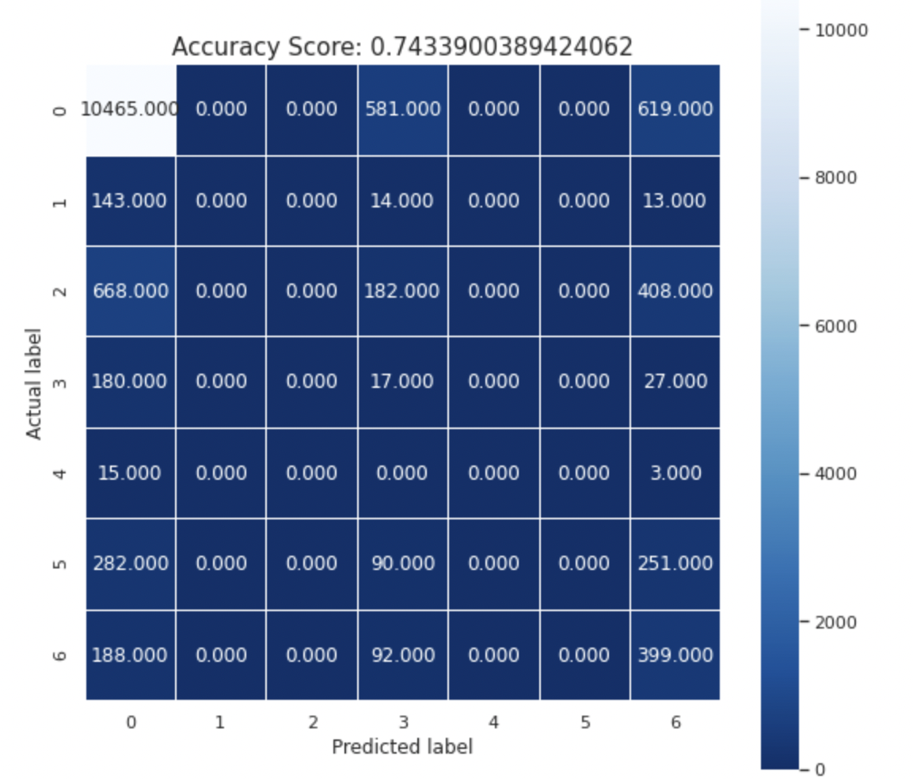
Results: Confusion matrix
Random forest classification
Gradient boosting classification

Slide 19
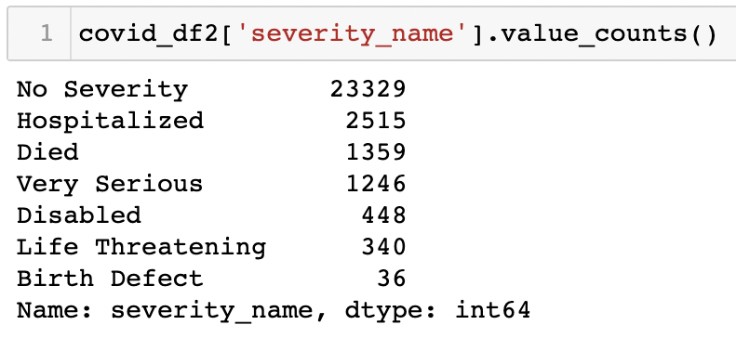
Problem:

Slide 20
Reducing target classes from 7 to 2
Combining 6 classes with sum value >=1 as one class – Severe side effects(1)
We have two classes now – No Severity(0) and Severe side effects(1)

Slide 21
Models Used
Logistic regression (acc = 0.834)
Random forest regression (acc = 0.835)
Gradient boosting classification (acc = 0.838)

Slide 22
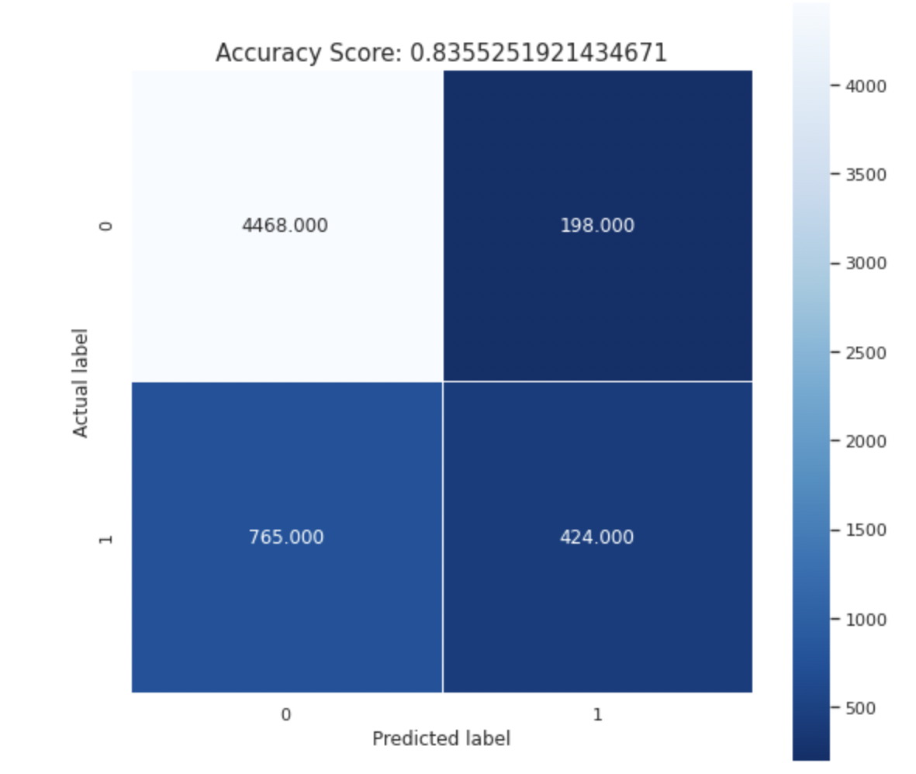
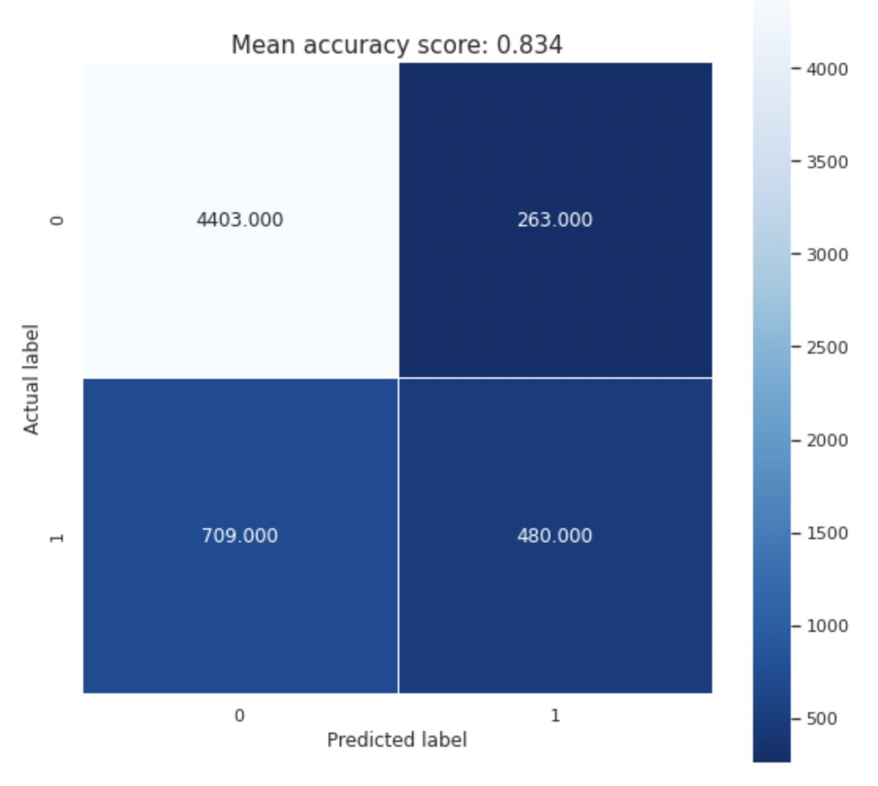
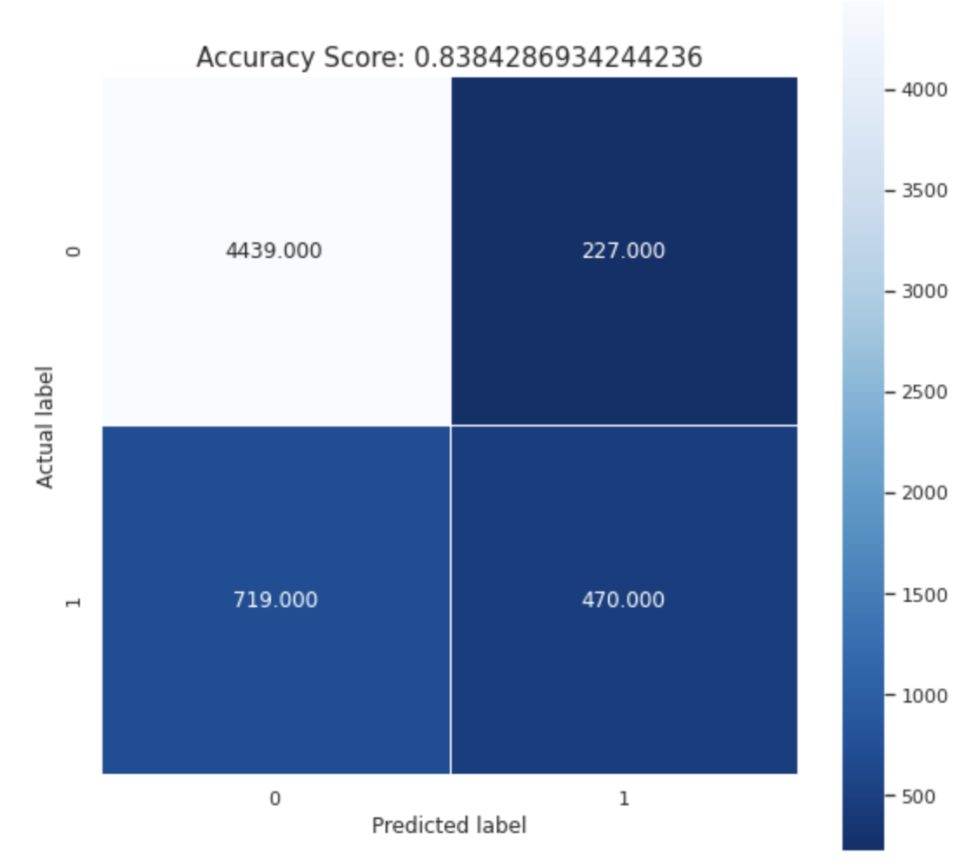
Results: Confusion matrix
Logistic regression
Random forest classification
Gradient boosting classification

Slide 23
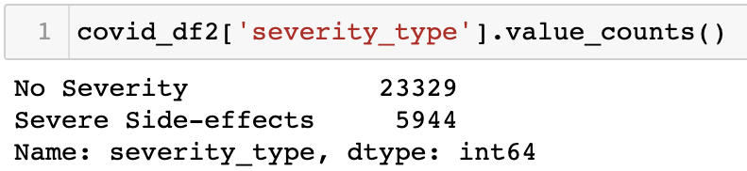
Problem:

Slide 24
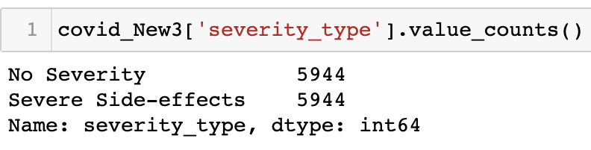
Improvement
Equalised the no.of rows for both classes
Took random 5944 rows from the class = No severity(0) and combined them with class = Severe side effects(1) and created a new data frame.

Slide 25
Models Used
Logistic regression
Random forest regression
Gradient boosting classification

Slide 26
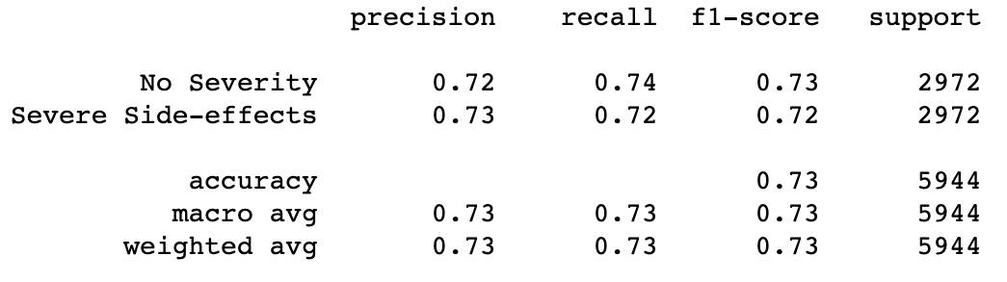
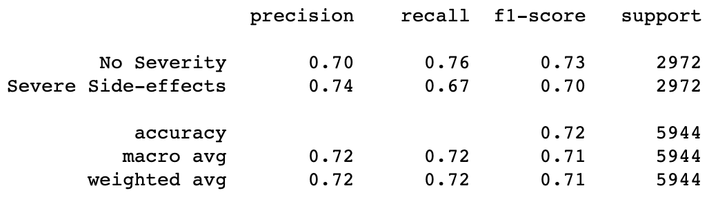
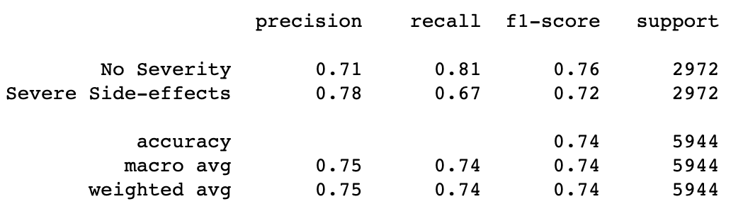
Results: Classification reports
Logistic regression
Random forest classification
Gradient boosting classification

Slide 27
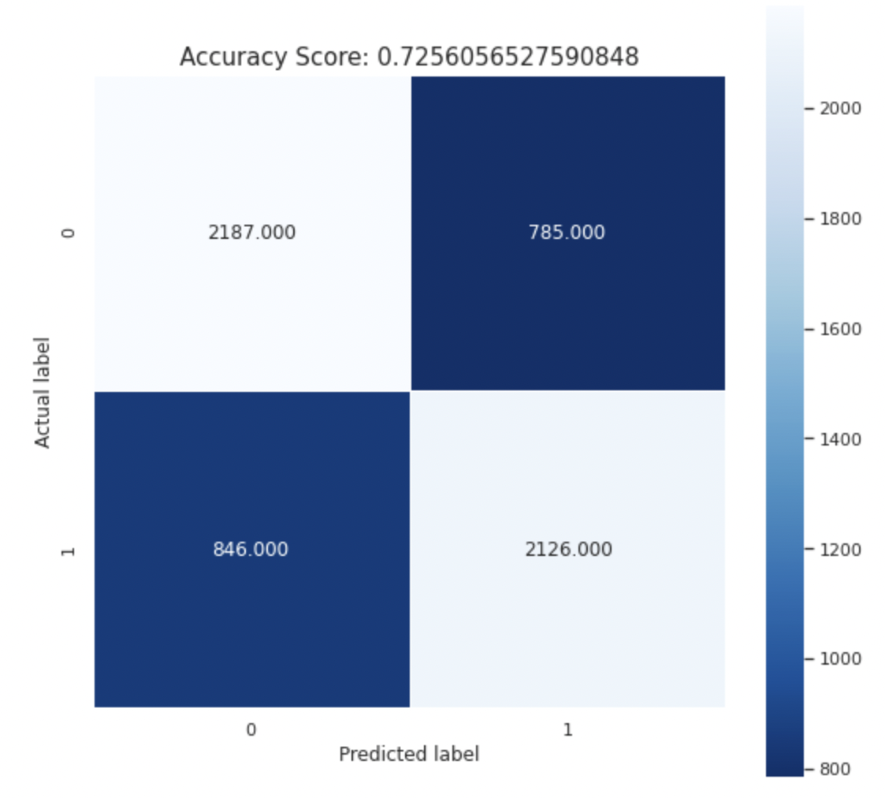
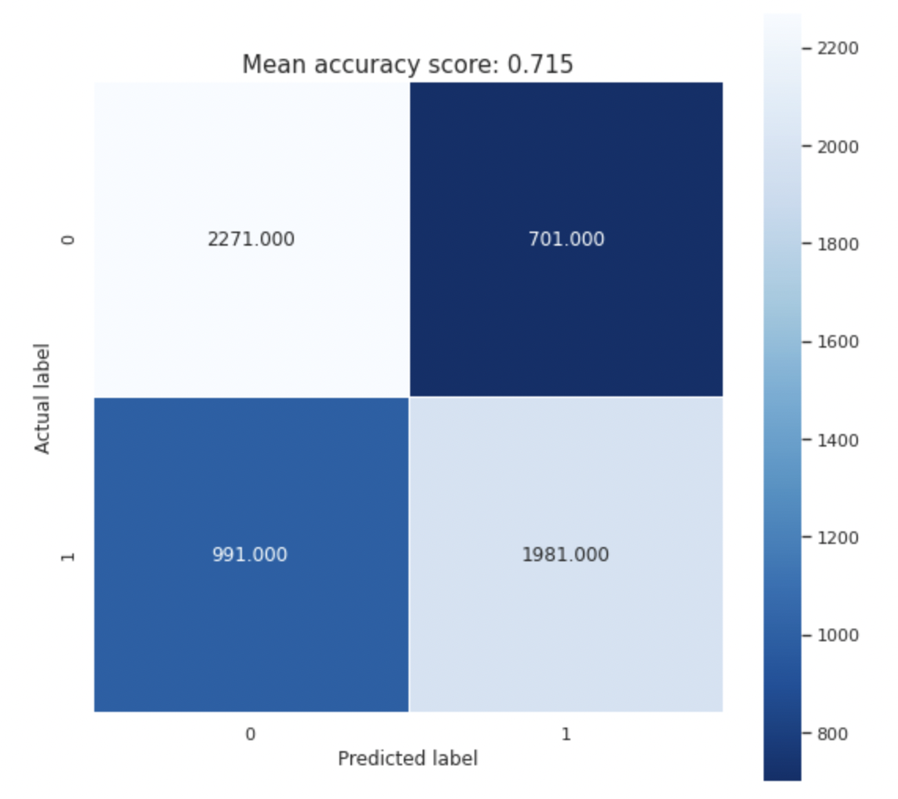
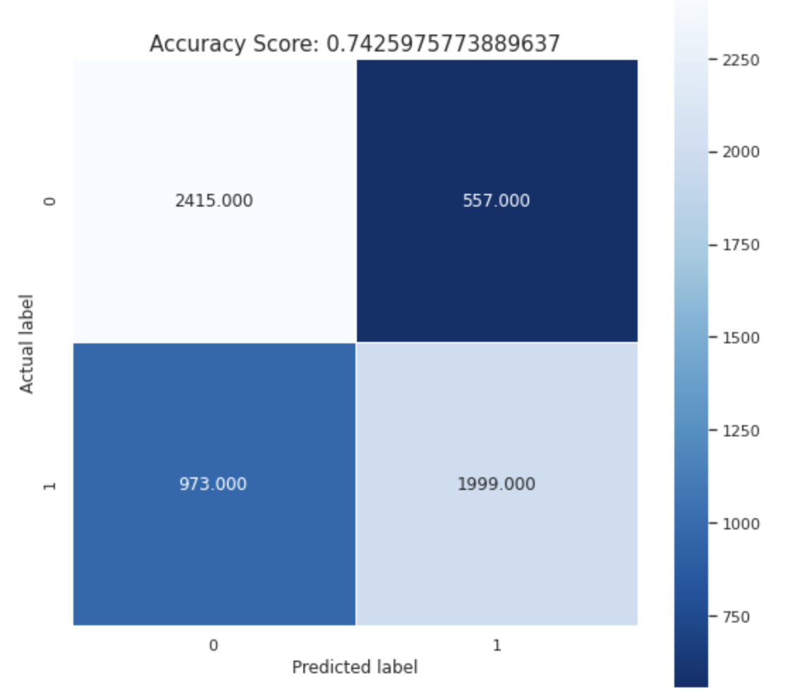
Confusion matrix:
Logistic regression
Random forest classification
Gradient boosting classification

Slide 28
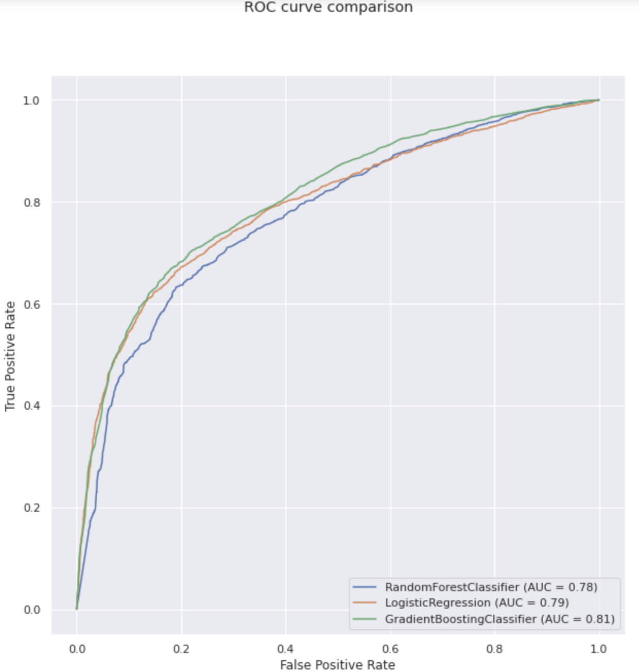
Results: ROC curve

Slide 29
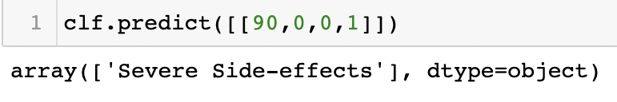
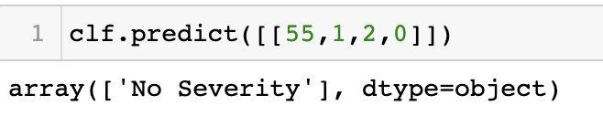
Results
Better models and more accurate results for both the classes
Predictions:
For gradient boosting classifier

Slide 30
Research Question
Is there a significant difference in age between patients who experienced no severe effects and patients who did?

Slide 31
Splitting data based on severity
We split the age of people on severity and no severity.
So, now we have Severity_age and No_severity age as two sets of data that we need to compare.

Slide 32
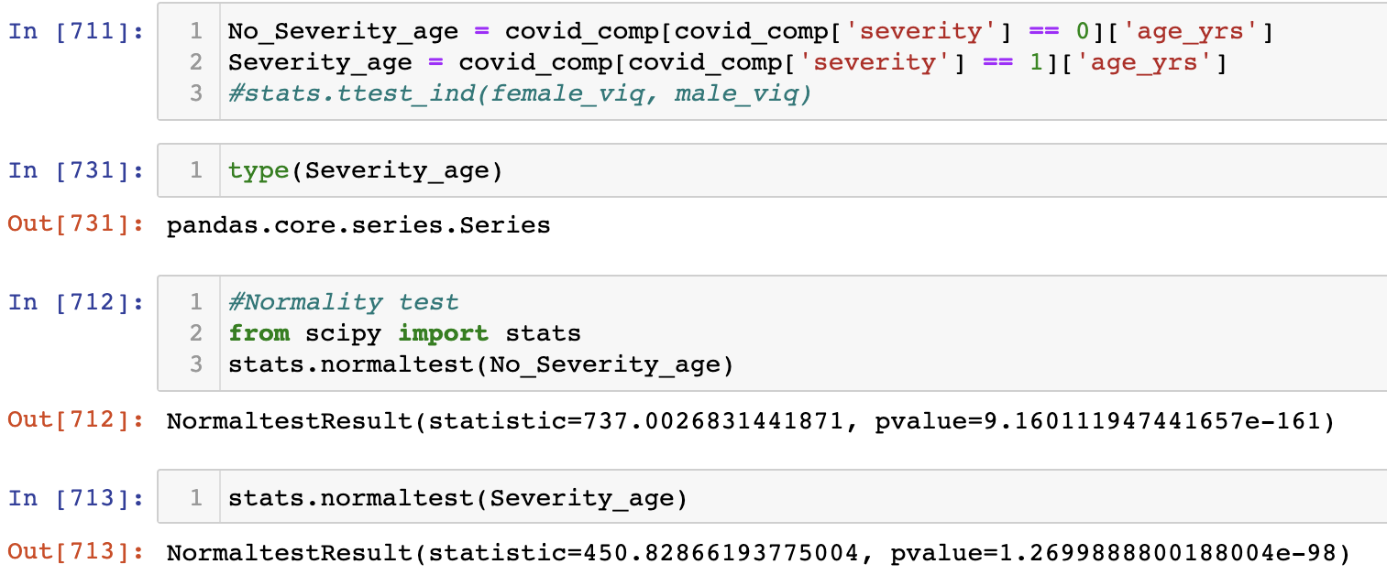
Normality test for both the data
As values for p are less than 0.05, we can reject null hypothesis and conclude that both the data are not normal.

Slide 33
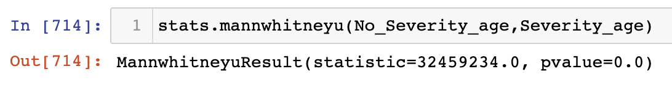
Performing the non parametric test
Mann whitney U test.
Null hypothesis: Both the data are similar
Alternate hypothesis: Both data are different
As the p-value is less than 0.05, we can reject null hypothesis and conclude that there is a significant statistical difference between the ages of the two groups.

Slide 34
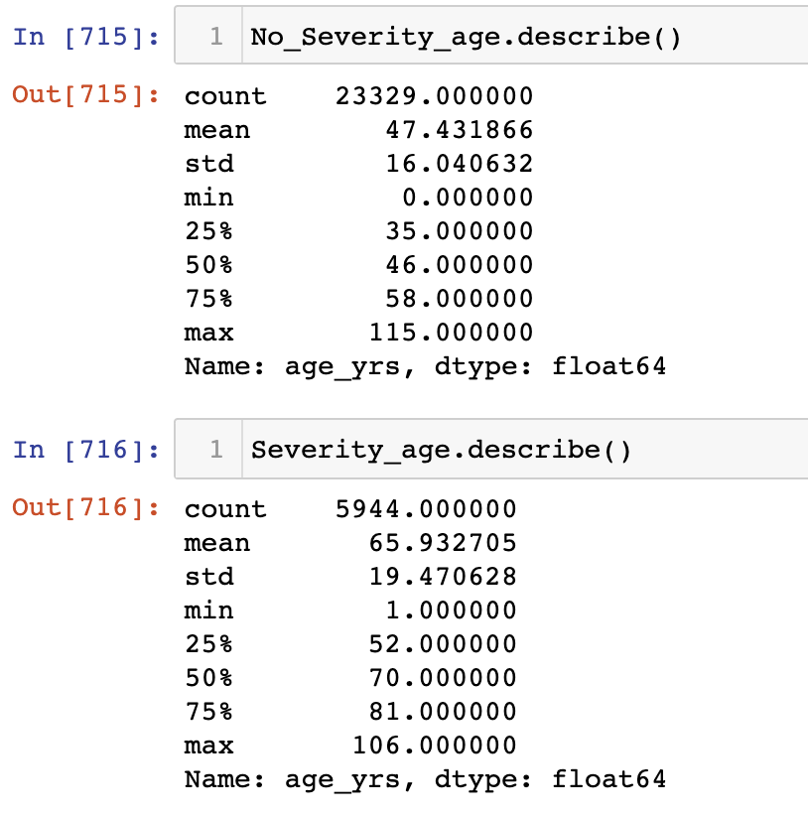
Using describe() function

Slide 35
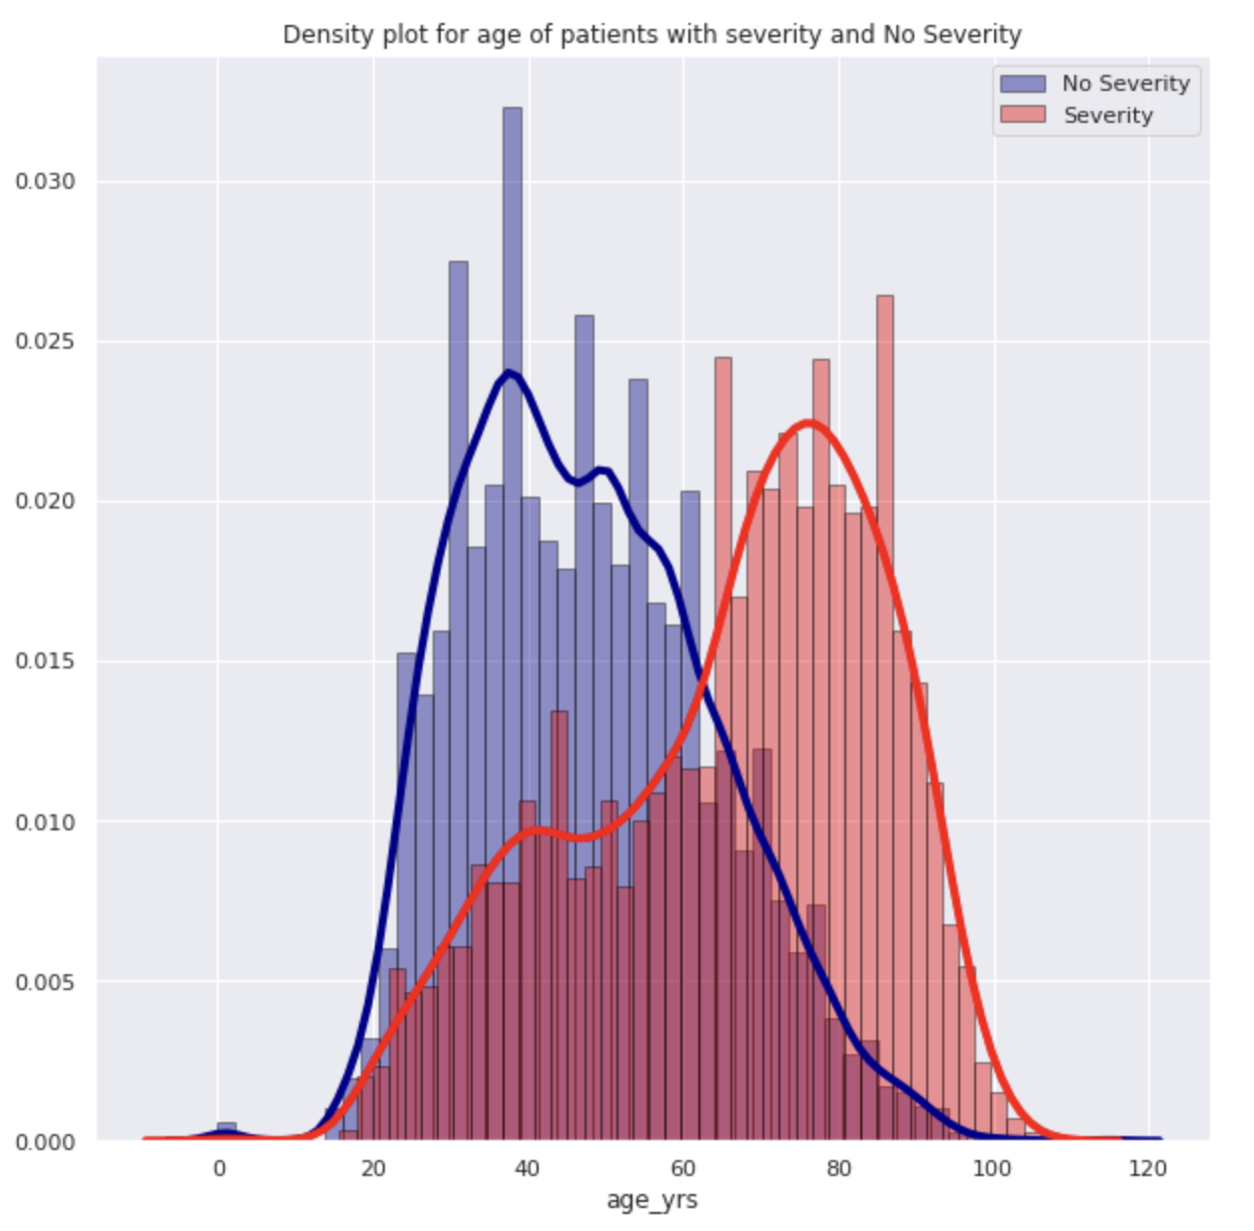
Histogram and density plots

Slide 36
Conclusion
There is a significant relationship (inverse, very weak) between number of days from vaccination to onset and the symptom count.
We were able to predict the severity of the adverse effect based on age, gender, vaccine manufacturer and medical history with an accuracy score of 0.74.
There is a significant difference in age of patients who experienced severe reactions and the patients who did not experience any severe reactions

Slide 37
Appendix
Importing the dataset
Data cleaning
Data cleaning cont.
Linear regression model
Polynomial regression model (degree=3)
Getting the target variable
Random forest classification
Gradient boosting classifier
Logistic regression
Classification report and confusion matrix
ROC curves
Splitting data based on severity

Slide 38
Importing the Dataset

Slide 39
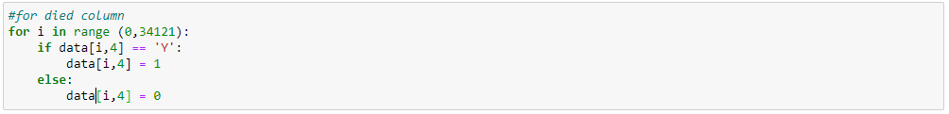
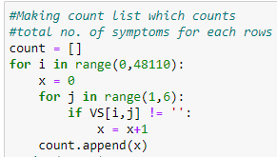
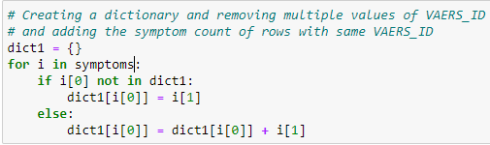
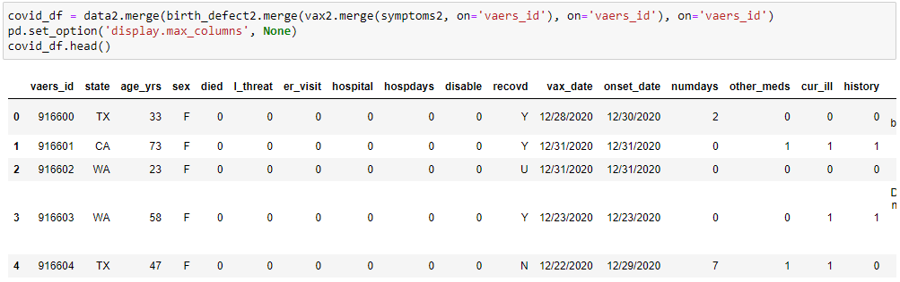
Data Cleaning

Slide 40
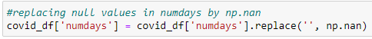
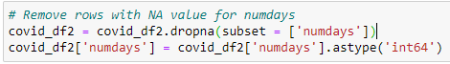
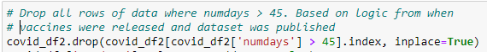
Data Cleaning cont.

Slide 41
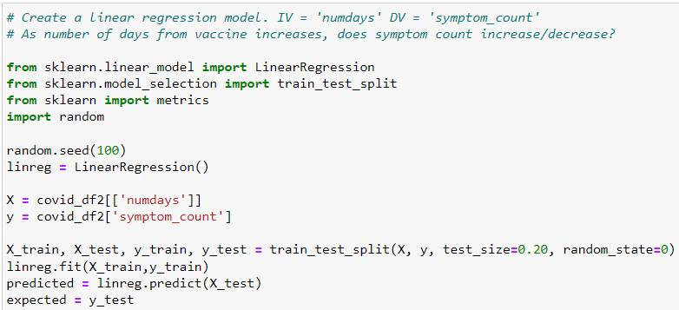
Linear Regression model:

Slide 42
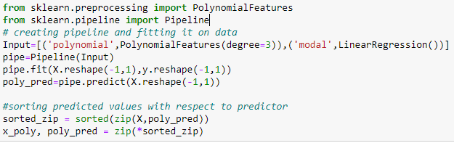
Polynomial Regression model: degree=3

Slide 43
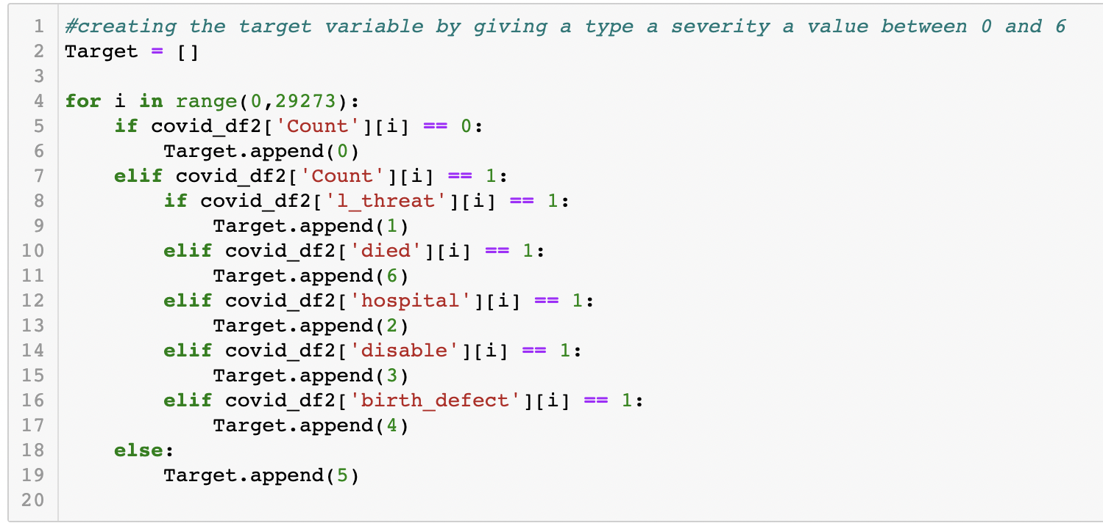
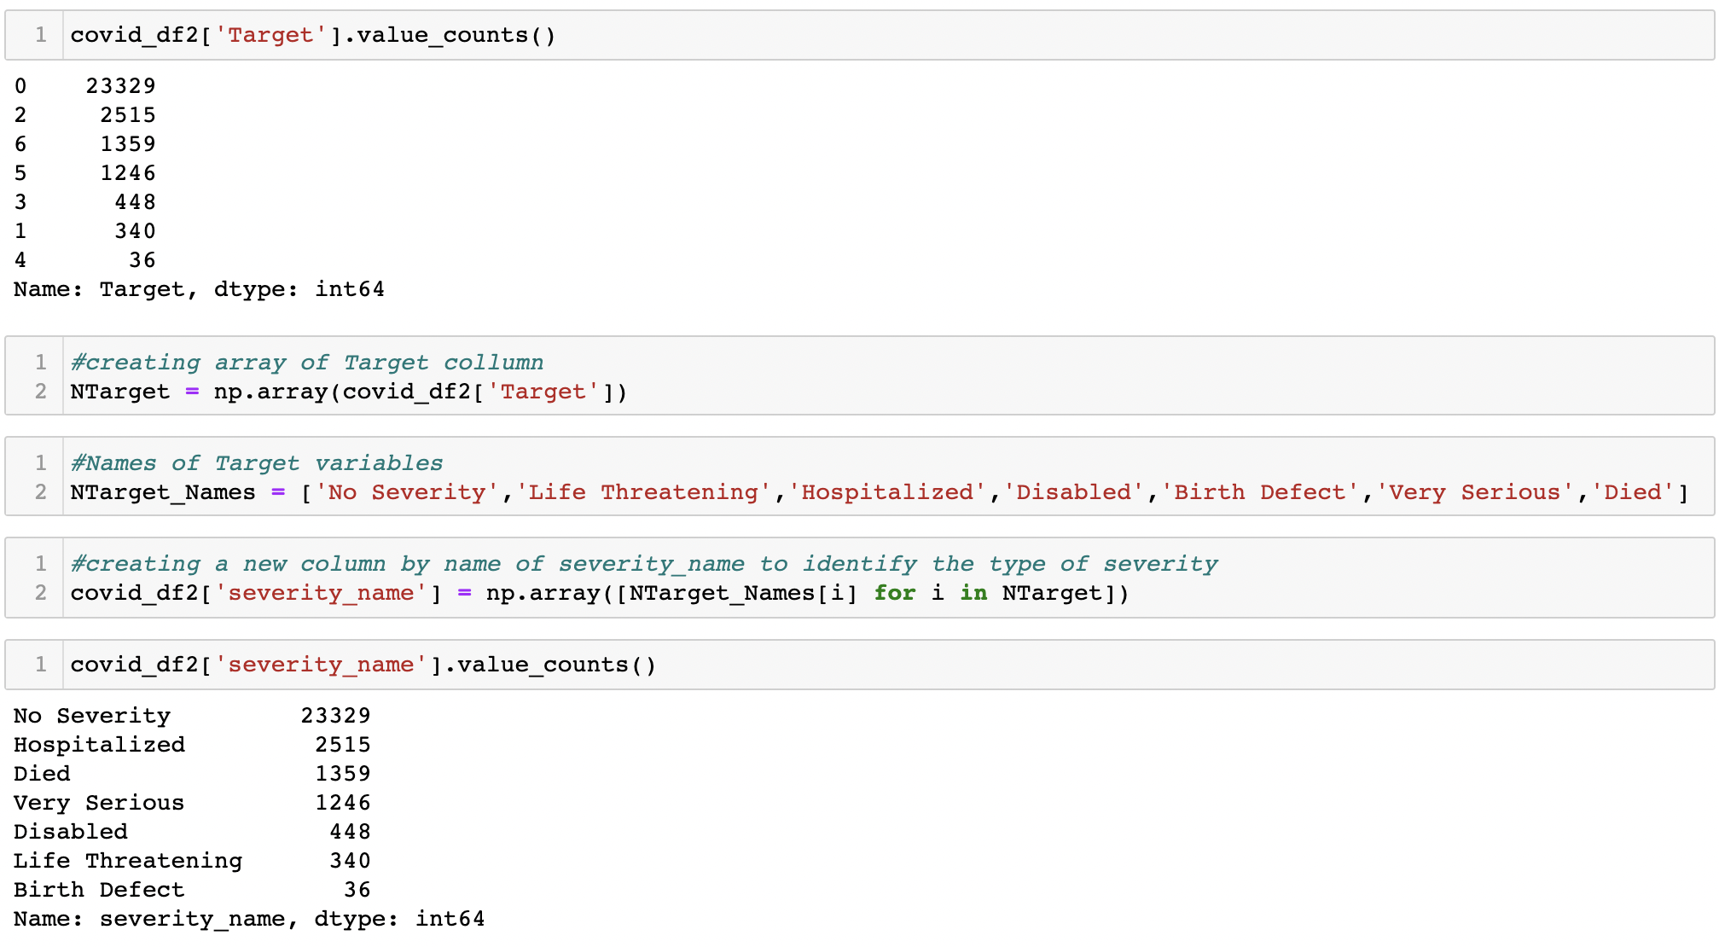
Getting the target variable

Slide 44
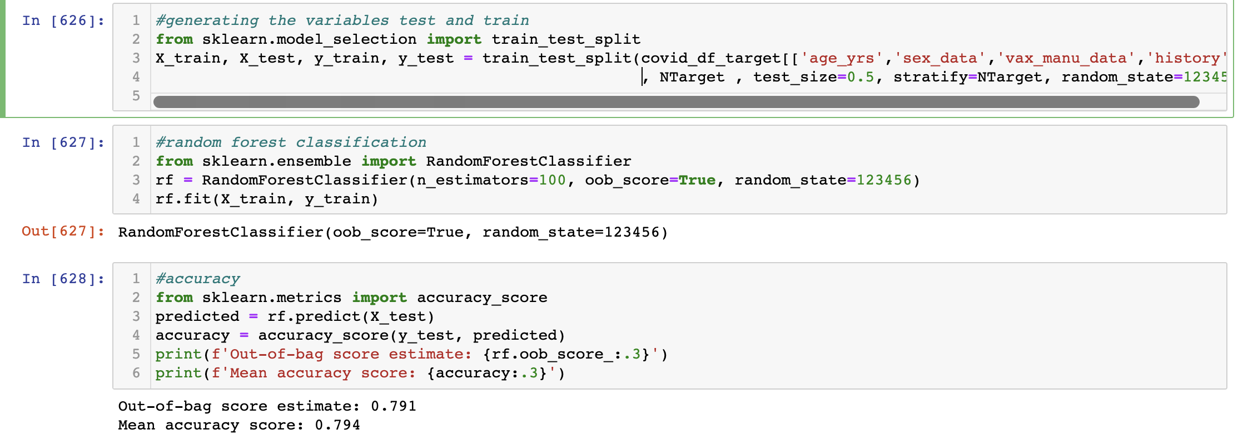
Random forest Classification

Slide 45
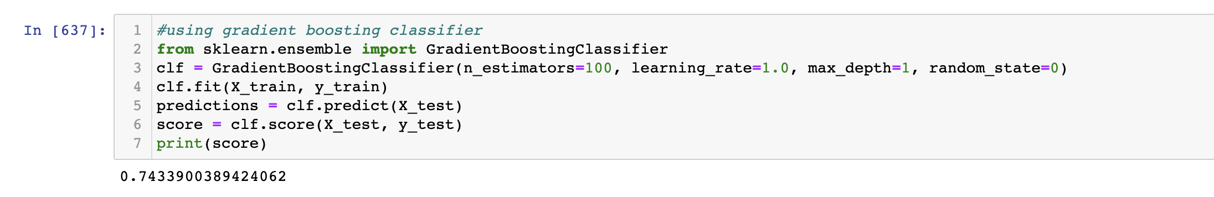
Gradient Boosting classifier

Slide 46
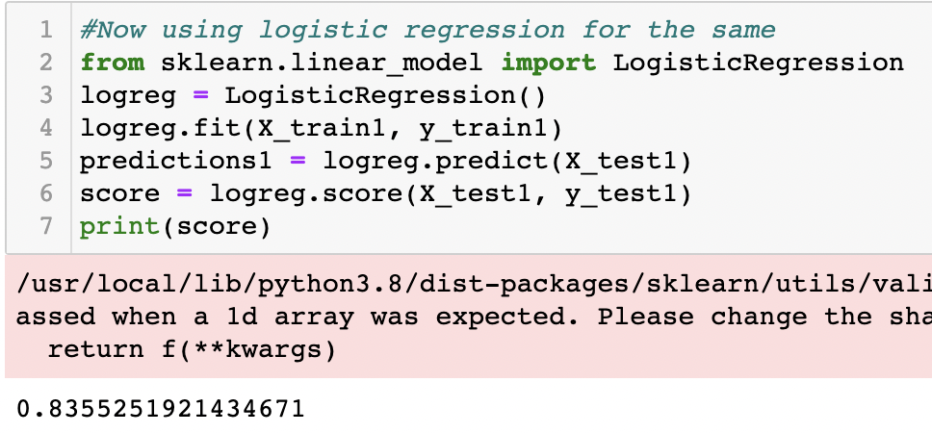
Logistic regression

Slide 47
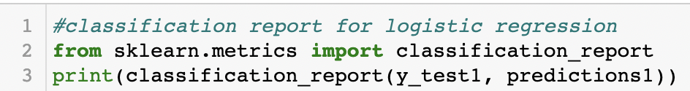
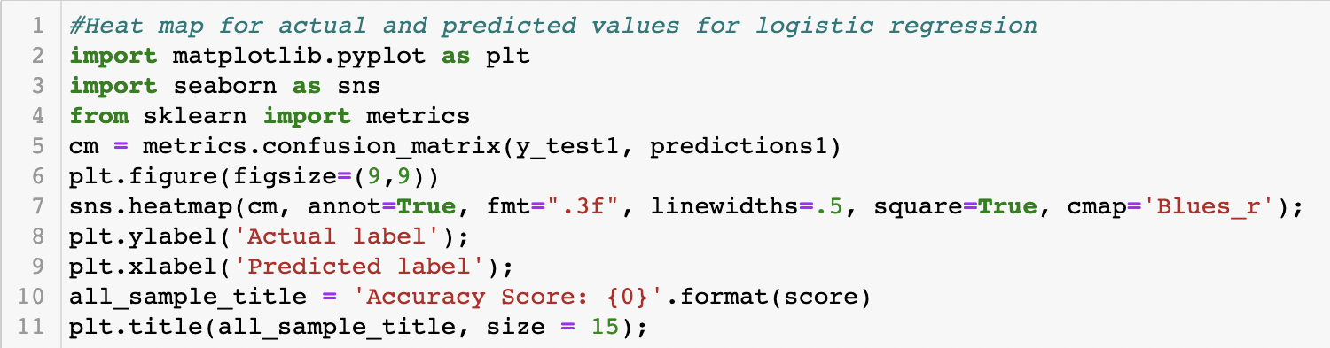
Classification report and confusion matrix

Slide 48

ROC curve

Slide 49

Splitting data based on severity

